Slide 1
Front End Engineering-I Project
Team Details:
Prathik Prajapati(2410991482)
Saideep Ghosh(2410991504)
Faculty Coordinator:
Dr N.Bharthiraja
Chitkara University Institute of Engineering and Technology,
Chitkara University, Punjab

Slide 2
Table of Contents
Introduction
Problem Statement
Technical Details
Key Features
Project Highlights
Bonus Feature(optional)
Conclusion
References/Links used

Slide 3
Introduction
"This responsive portfolio project showcases my skills, projects, and experiences using modern web technologies like HTML, CSS, and JavaScript. It highlights interactivity, responsiveness, and clean design for an engaging user experience.“

Slide 4
Problem Statement
Objective: Create a responsive portfolio website showcasing projects and skills.
Approach:
- Design the HTML structure for the portfolio with sections for projects, skills, and about me. - Utilize CSS media queries to adapt the layout for different screen sizes.
- Apply Flexbox or Grid for arranging project cards.
Use JavaScript to add interactivity and animations for a more engaging experience.
Bonus Features:
- Implement a filter option to sort projects by category or technology.
- Add a lightbox gallery for displaying project images in a popup.
- Create a progress bar for showcasing skill levels.
- Incorporate a contact form for potential clients or employers.

Slide 5
Technical Details
HTML5: Used for structuring the content, including sections like navigation, About, Education, Experience, and Contact. Each section has a specific purpose within the portfolio website.
CSS Styling: Embedded in thetag, used to design the layout, making the site visually appealing with background gradients, sticky navigation, and a responsive timeline.
JavaScript Libraries:
jQuery: Included via CDN for manipulating DOM elements more easily and adding interactive behavior.
Typed.js: A JavaScript library used to animate text, which adds a dynamic typing effect to the "Web Developer" text in the About section.
Responsive Design: Media queries are used to make the website adapt to different screen sizes, ensuring a smooth experience across desktop and mobile devices.
Modal Popups: Included in the Contact section to allow users to interact through a form. The modal is designed to display a popup with input fields for sending messages.

Slide 6
Key Features
1. Responsive Design:
Ensures the portfolio looks great on all devices (desktop, tablet, mobile).
Utilizes CSS Media Queries for layout adjustments based on screen size.
2. Interactive Navigation:
A sticky navigation bar for easy access to all sections.
Smooth scrolling effect for a seamless user experience.
3. Project Showcasing:
Organized project section with a filter option to categorize projects.
Lightbox gallery for viewing project images with enhanced visuals.
4. Skill Progress Indicators:
Dynamic progress bars to visually display skills and expertise.
Circular progress charts for highlighting key competencies.
5. Contact Form:
A functional and responsive contact form with validation.
Modal-based pop-up design for an unobtrusive user interface.
6. Downloadable CV:
Option to download the CV directly from the site.
Styled buttons with clear call-to-action.
7. Animations & Interactivity:
JavaScript animations (like typing effect) for engaging the audience.
Hover and click effects for an interactive experience.

Slide 7

Project Highlights(Nav Bar)
CSS
JS
HTML

Slide 8


Project Highlights(About Me)
HTML
CSS
JS

Slide 9
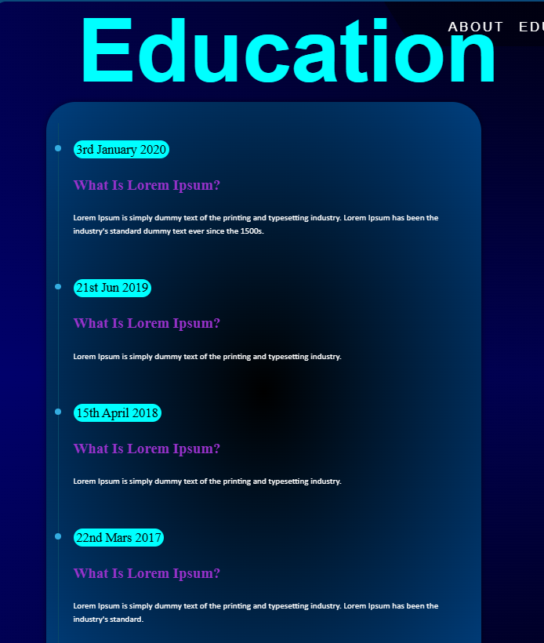
Project Highlights(Timeline)
HTML
CSS

Slide 10
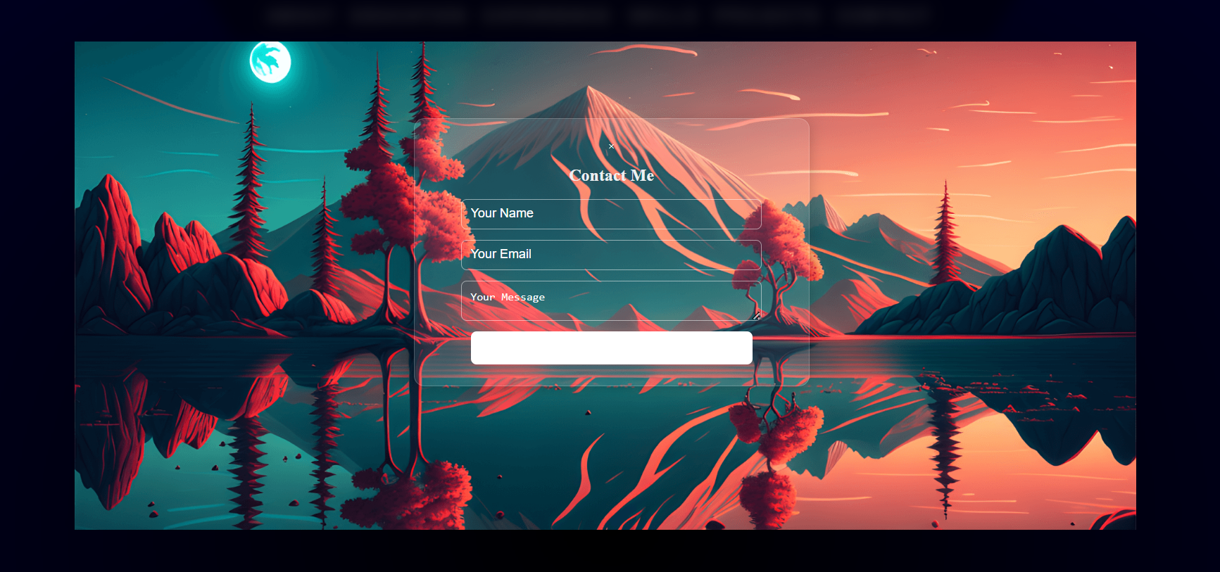
Project Highlights(Contact-me)
css
html
js

Slide 11
Conclusion
Summary of Key Points:
Developed a user-friendly, responsive portfolio website
Implemented features include a filter option for projects and an interactive contact form
Technologies used: HTML, CSS, JavaScript.
Team's Main Takeaways:
Importance of collaboration and clear communication
Gained proficiency in responsive web design and JavaScript
Developed problem-solving skills through challenges faced
Future enhancements: User feedback integration and additional features based on user needs

Slide 12


